Slide 1
EDES 301 PocketTetris Proposal
September 30, 2024
Renee Wrysinski

Slide 2
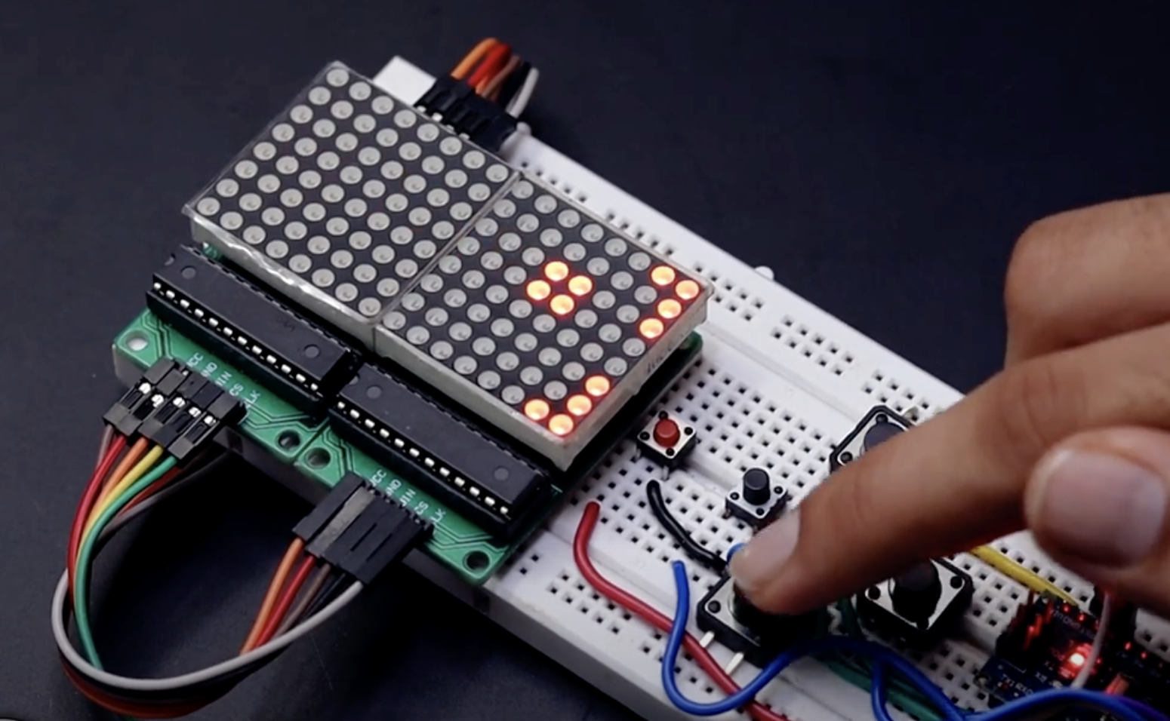
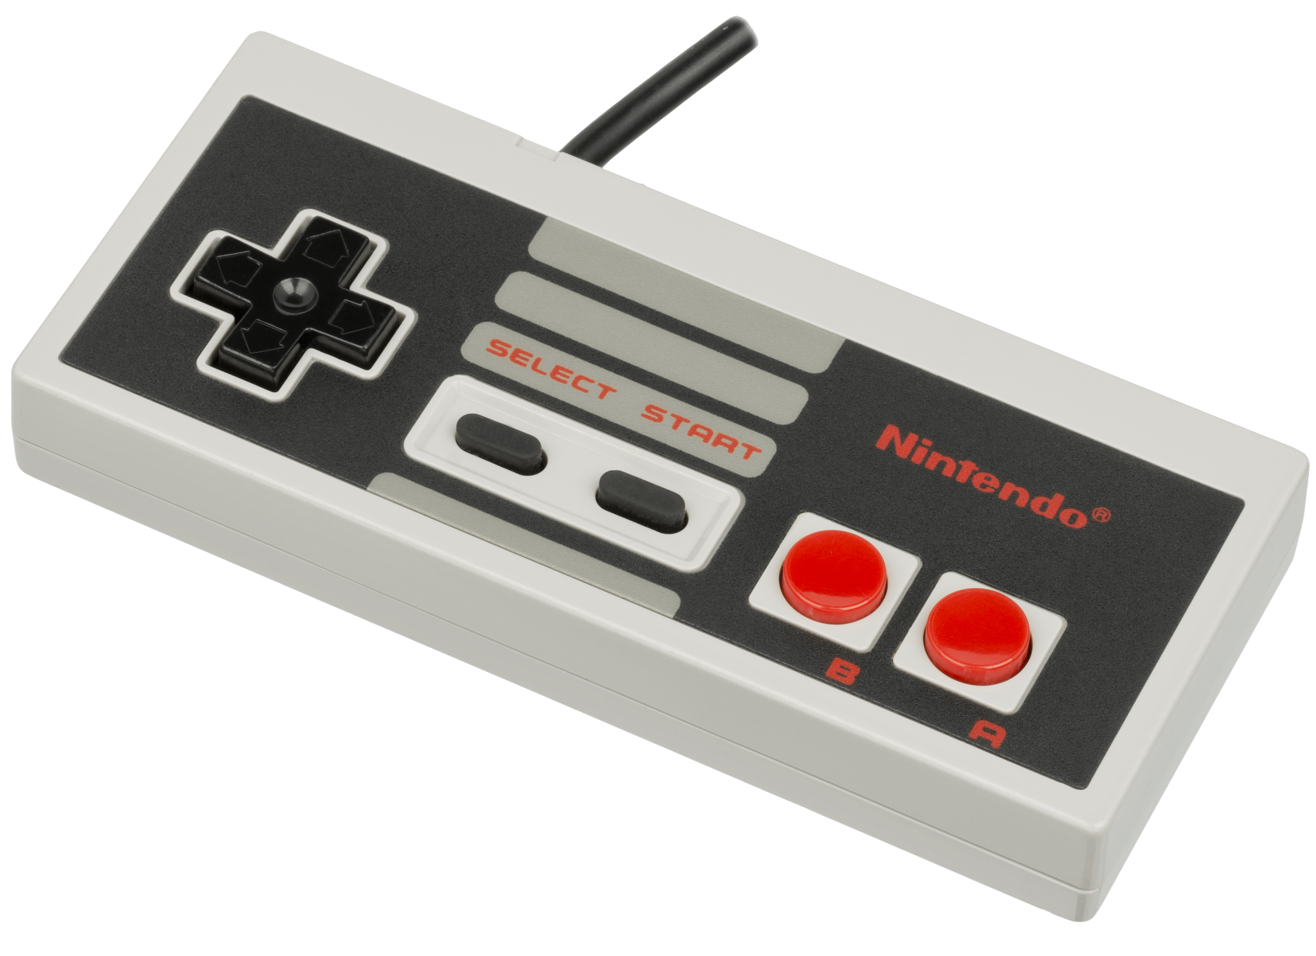
Background Information
I really enjoy playing Tetris, and I think it would be fun to recreate it myself using the PocketBeagle!
There are many existing projects recreating Tetris on Raspberry Pi & Arduino
One example: https://youtu.be/aDWXKUFqpDo
The majority of these projects do not use color displays or play the theme, so I want to create a version that displays the classic Tetris block colors and plays a simple version of the theme tune
I will play the theme using a passive piezo buzzer (idea from https://youtu.be/PQ-R4jSbwAo)
I also want to incorporate 6 buttons instead of the typical 4 or 5 to give the game more functionality (buttons mirroring the functionality of NES Tetris)

Slide 3
System Block Diagram
PocketBeagle
2.8” TFT LCD (ILI9341)
SPI0, 3.3V, GND (P1.6, P1.8, P1.10, P1.12, P1.14, P1.16)
Button x6
Piezo Buzzer (PS1240)
6 GPIO
(P2.25, P2.27, P2.29, P2.31, P2.33, P2.35)
PWM1A (P2.1)

Slide 4
Power Block Diagram
PocketBeagle
2.8” TFT LCD (ILI9341)
SPI0, 3.3V, GND (P1.6, P1.8, P1.10, P1.12, P1.14, P1.16)
3.3V, ≤150mA
Button x6
Piezo Buzzer (PS1240)
3.3V
6 GPIO
(P2.25, P2.27, P2.29, P2.31, P2.33, P2.35)
PWM1A (P2.1)
3.3V, ≤5mA

Slide 5
Components / Budget
Component | EDES301 to Buy? | Cost
SPI Screen: https://www.adafruit.com/product/1770 | Yes | $29.95
Piezo Buzzer: https://www.adafruit.com/product/160 | Yes | $1.50
6x Buttons: https://www.adafruit.com/product/1119 | No (from OEDK) | $2.50

